Slide 1
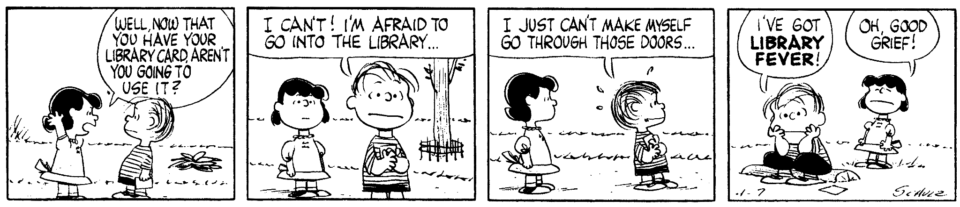
Library Orientation
Finding Your Way Around
Schulz, C. (1960, April 7). Peanuts [daily strip].
Notes:
Hi, I’m Michelle, and I work in the Library on level 2.

Slide 2
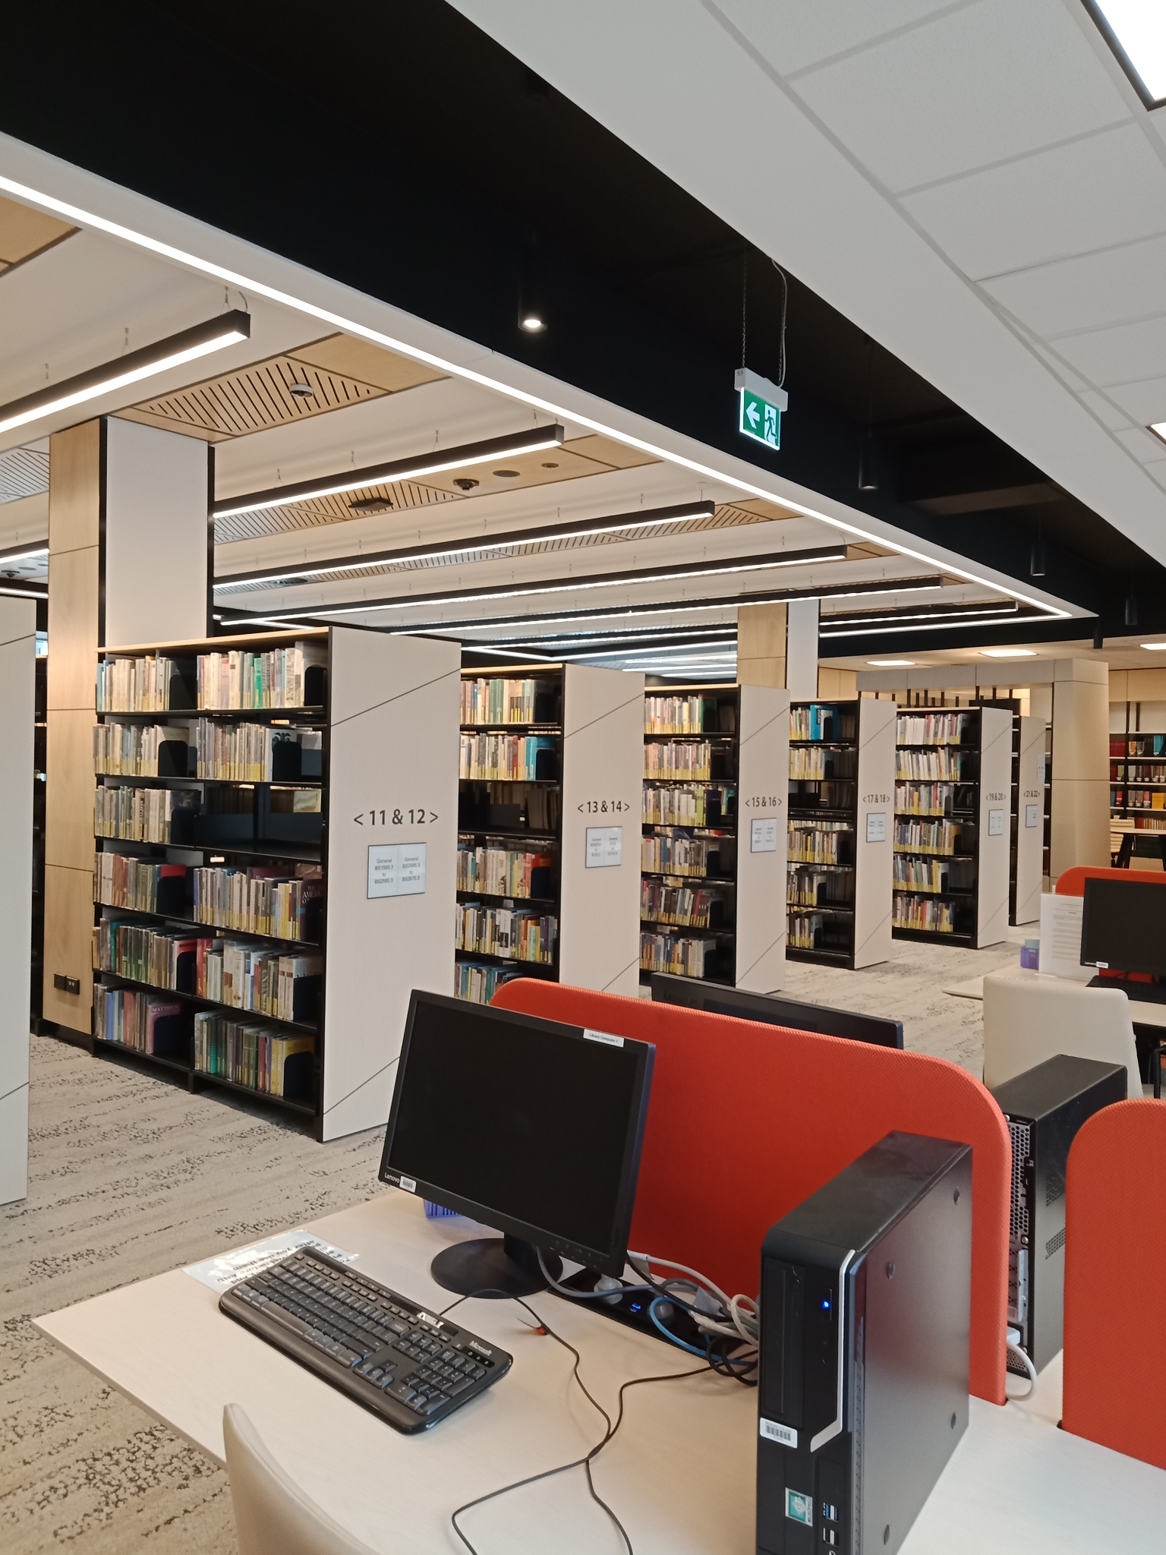
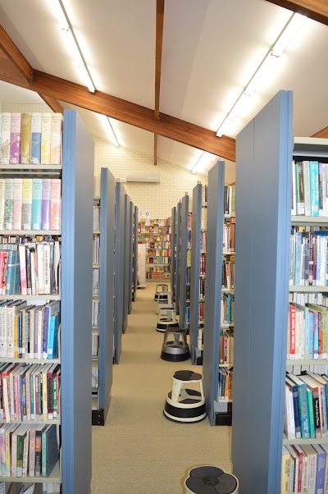
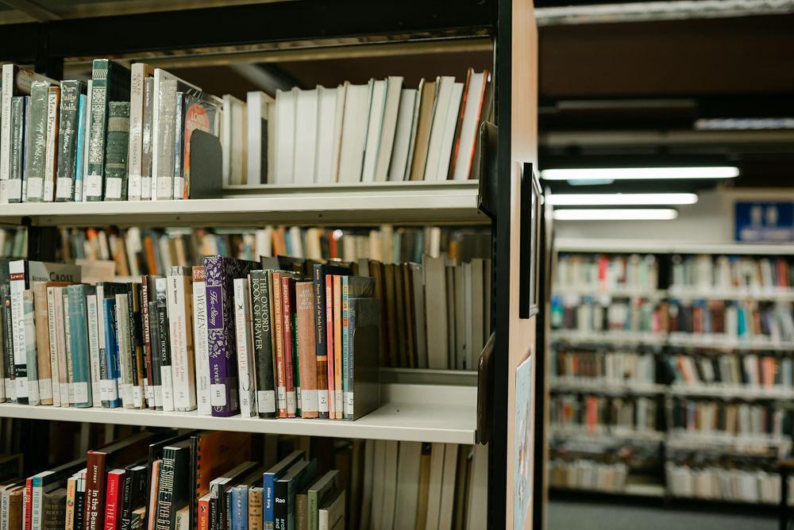
One Library, Three Branches
Gilbert Wright Library, Sydney
Heather and Noel Vose Library, Perth
TJ Malyon Library, Brisbane
219,000 resources
Over 75,000 eBooks
Journal databases

Slide 3
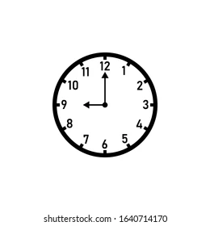
Opening hours during Semester
Level 1 - Study Hub
A shared space for quiet study and group learning
Access via the Level 1 foyer → 8.30am to 10.00pm weekdays during Semester
Accessible at other times with a student swipe card
Full guidelines are available on the Study Hub noticeboard
Level 2 - Library collection
Monday - 9am to 5pm
Tues & Wed- 9am to 6.45pm
Thurs & Fri - 9am to 5pm
Saturday - 9am to 3pm
Sunday and public holidays - Closed
https://www.morling.edu.au/library

Slide 4








What can the library help with?
libraryhelpdesk@morling.edu.au
Notes:
When did you last use an academic library? What did you use it for?
We can help in lots of ways - finding books (including posting them to distance students), keeping up to date with research, accessing paid resources, printing, search strategies, study spaces, and the whole research process.
The library also has reference and not for loan collections that are only available on campus. This is where we have your textbooks, encyclopedias, dictionaries and some commentaries - important books to use!

Slide 5



What CAN’T the library help with?
academictutor@morling.edu.au
Notes:
We can help with lots of things - but a few things we DON’T do include writing and editing essays, and knowing all your marking criteria and lecturers’ expectations.

Slide 6
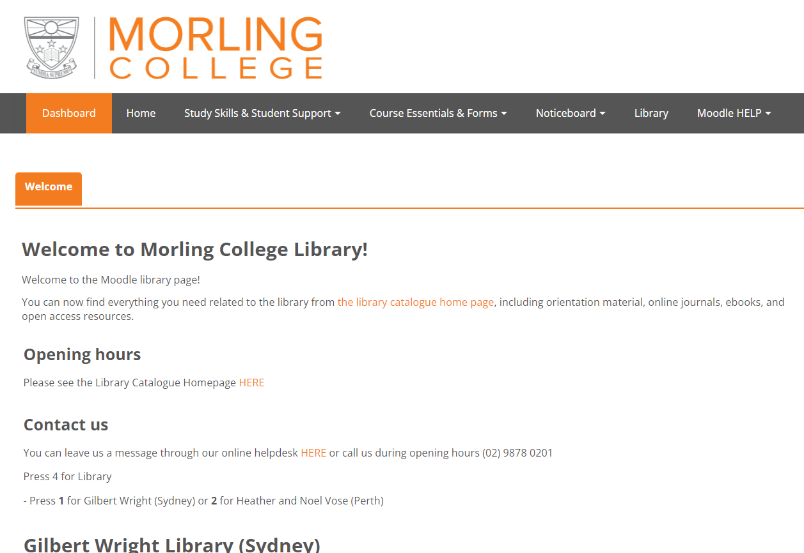
The Library on Moodle
https://www.morlingonline.edu.au/

Slide 7
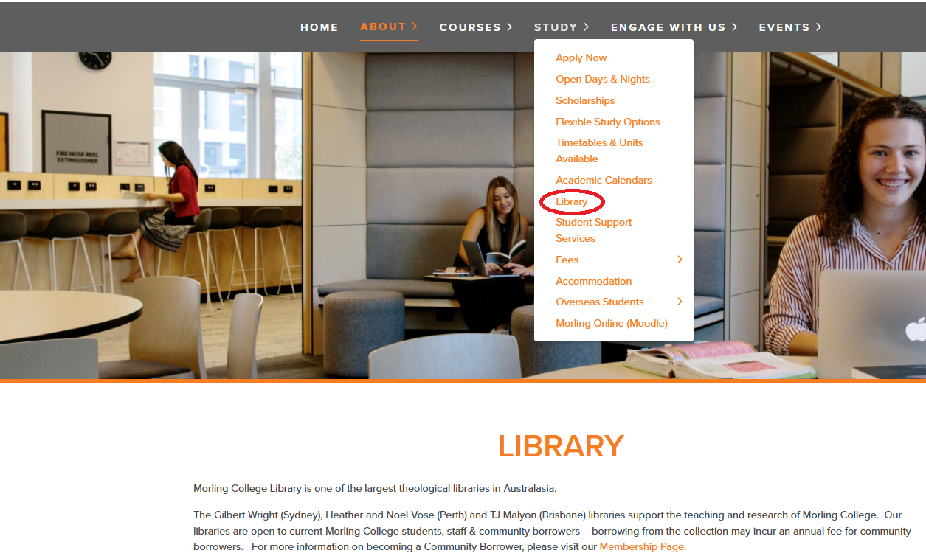
The Library Website
https://www.morling.edu.au/library

Slide 8
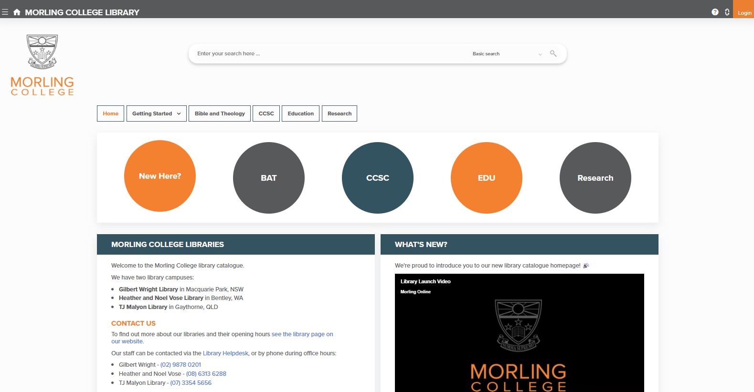
Library catalogue: Home
Basic and advanced search options
https://morling.softlinkhosting.com.au/liberty
Borrowing:
20 books
4 weeks
4 renewals
Notes:
This is the homepage of the library catalogue. On the Top middle is the search bar - and notice that there are options for both basic and advanced searching, to use some of the search techniques we’ll be learning. Top right is the login button. The circles in the middle is all about online resources for each of the departments at Morling. This is where the links to our journal databases and eBook collections are.

Slide 9
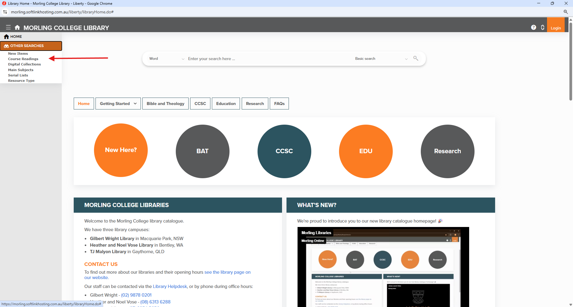
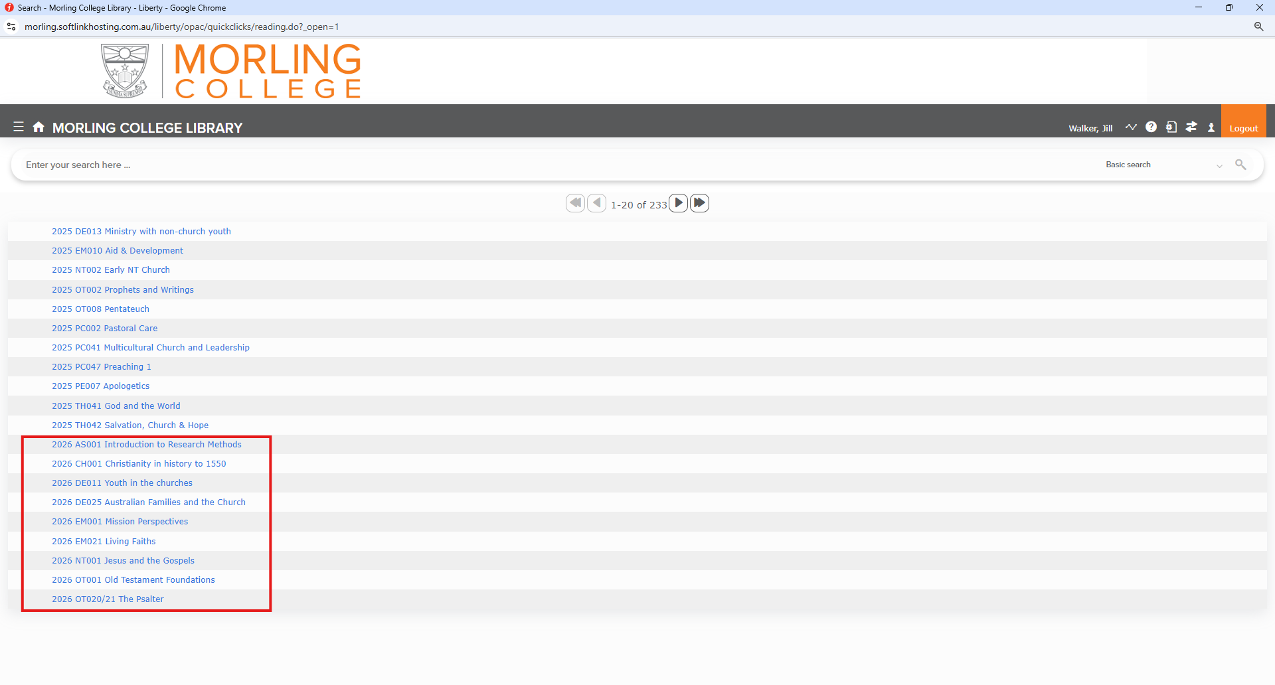
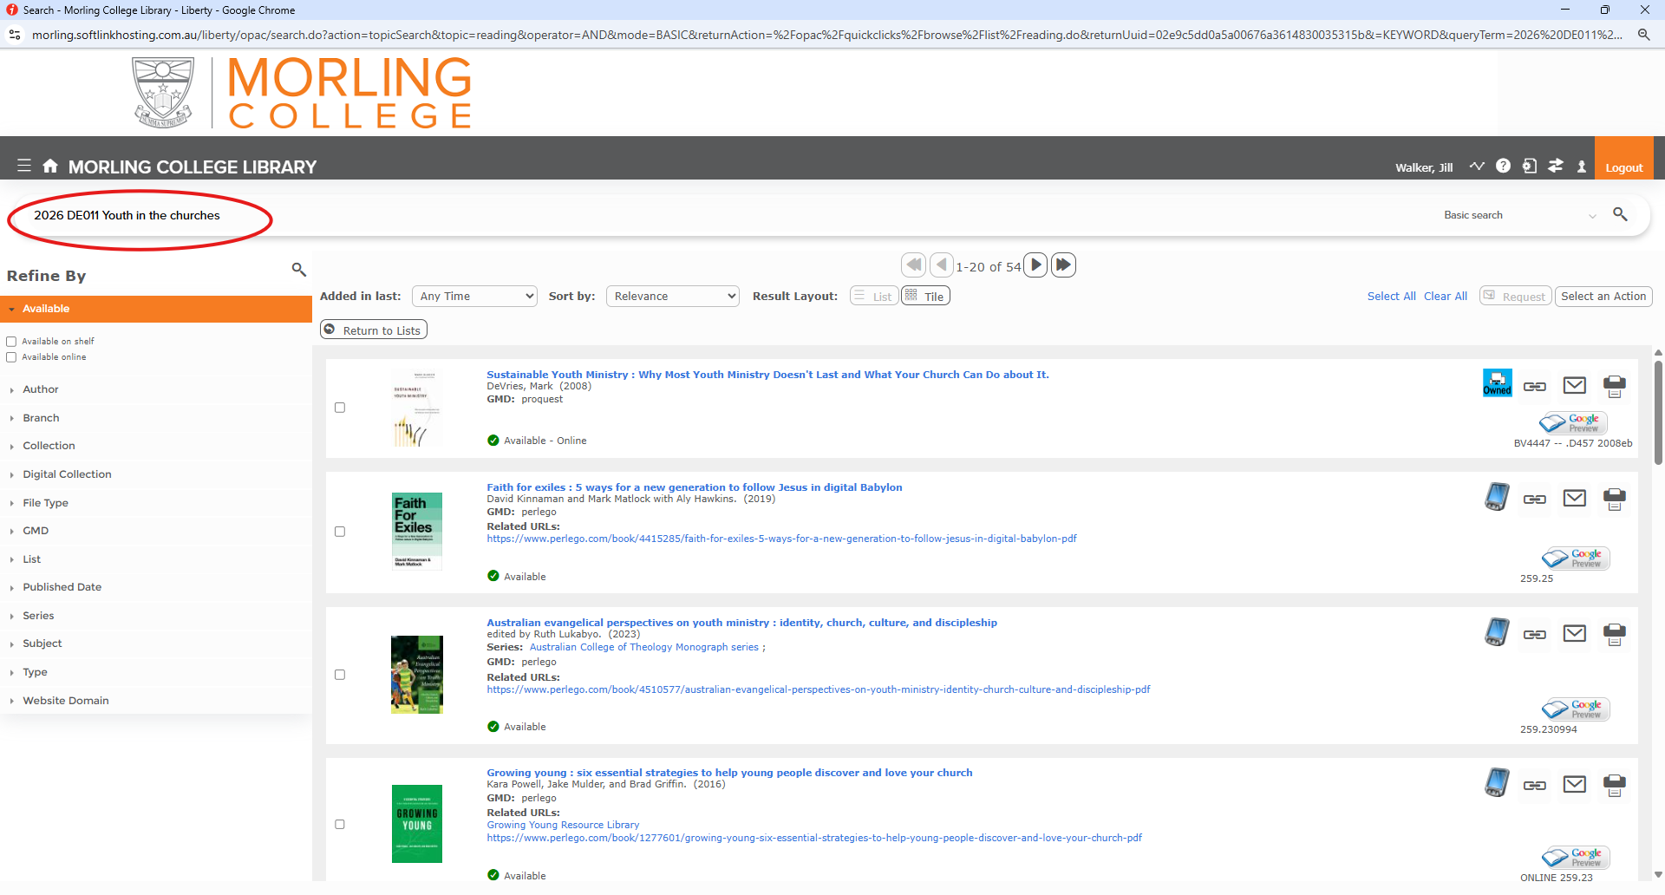
Course Reading Lists

Slide 10
Online Resources
eBooks |  |  |  |  | Journals
Perlego account | Wheelers account | OpenAthens account
Perlego Online Library | Wheelers Books | ProQuest Ebook Central | JSTOR | EBSCO (eBooks and journals) |  | ProQuest journals
Access
Platform
Notes:
Before we get to searching the databases, it’s helpful to know how to access the resources. These are our primary eResource platforms. There are quite a few of them, and they have different login systems. As you can see, OpenAthens is the main login system for our online resources, and the library creates an account for you. BUT, you will still need to use Perlego and Wheelers, so remember to register for them!
Each platform has its own quirks and features. For me, something that stands out between ProQuest and EBSCO is that when you search on EBSCO, you can search for eBooks and journal articles on the same platform. When you’re using ProQuest, you need to search for journals on one platform, and eBooks on another platform.

Slide 11
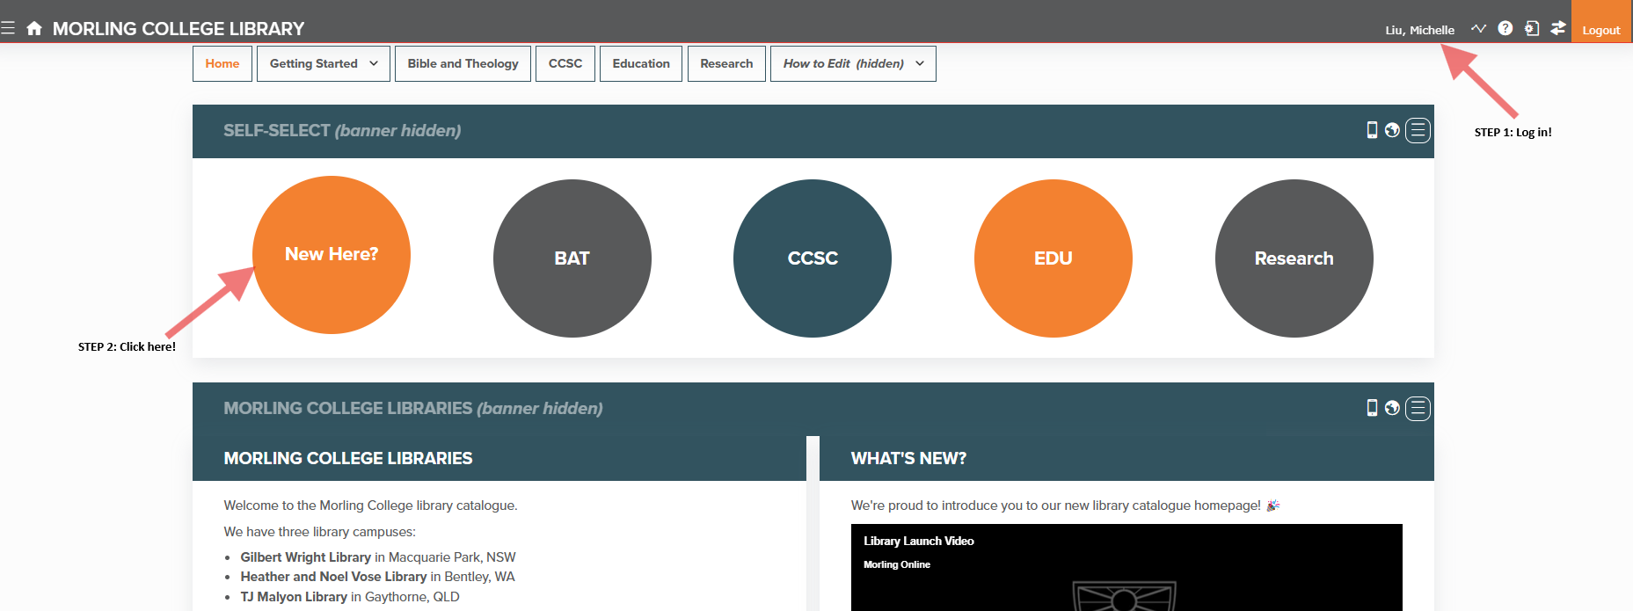
Online Resources – Perlego 1
Notes:
Before we get to searching the databases, it’s helpful to know how to access the resources. These are our primary eResource platforms. There are quite a few of them, and they have different login systems. As you can see, OpenAthens is the main login system for our online resources, and the library creates an account for you. BUT, you will still need to use Perlego and Wheelers, so remember to register for them!
Each platform has its own quirks and features. For me, something that stands out between ProQuest and EBSCO is that when you search on EBSCO, you can search for eBooks and journal articles on the same platform. When you’re using ProQuest, you need to search for journals on one platform, and eBooks on another platform.

Slide 12
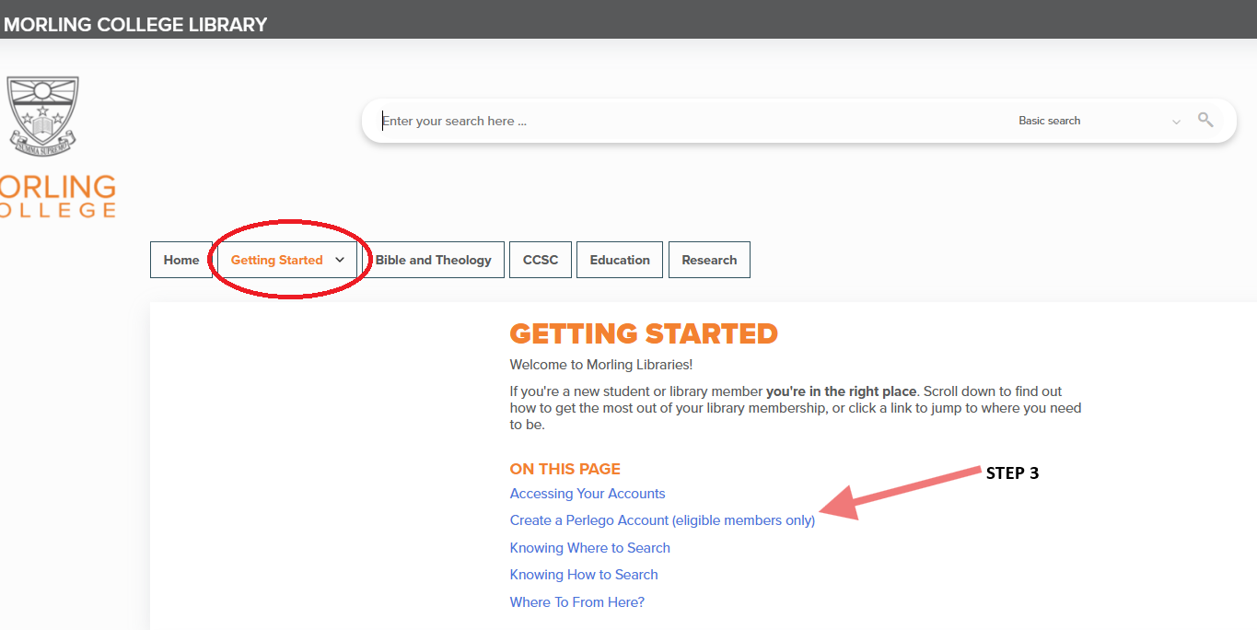
Online Resources – Perlego 2
Notes:
Before we get to searching the databases, it’s helpful to know how to access the resources. These are our primary eResource platforms. There are quite a few of them, and they have different login systems. As you can see, OpenAthens is the main login system for our online resources, and the library creates an account for you. BUT, you will still need to use Perlego and Wheelers, so remember to register for them!
Each platform has its own quirks and features. For me, something that stands out between ProQuest and EBSCO is that when you search on EBSCO, you can search for eBooks and journal articles on the same platform. When you’re using ProQuest, you need to search for journals on one platform, and eBooks on another platform.

Slide 13
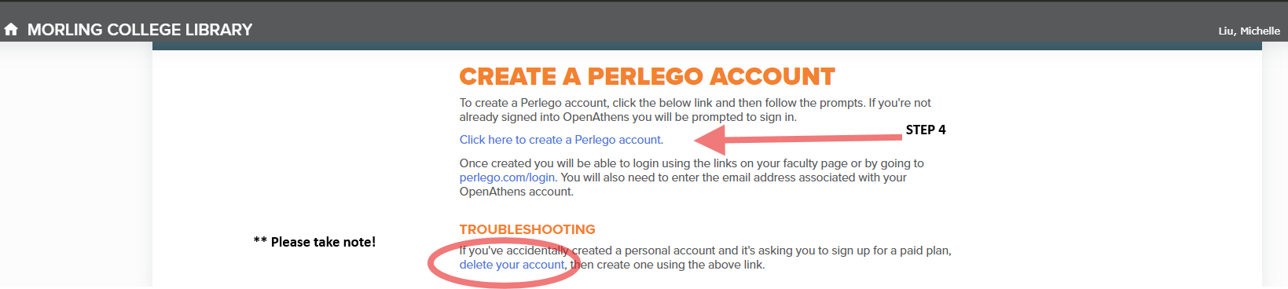
Online Resources – Perlego 3
Notes:
Before we get to searching the databases, it’s helpful to know how to access the resources. These are our primary eResource platforms. There are quite a few of them, and they have different login systems. As you can see, OpenAthens is the main login system for our online resources, and the library creates an account for you. BUT, you will still need to use Perlego and Wheelers, so remember to register for them!
Each platform has its own quirks and features. For me, something that stands out between ProQuest and EBSCO is that when you search on EBSCO, you can search for eBooks and journal articles on the same platform. When you’re using ProQuest, you need to search for journals on one platform, and eBooks on another platform.

Slide 14
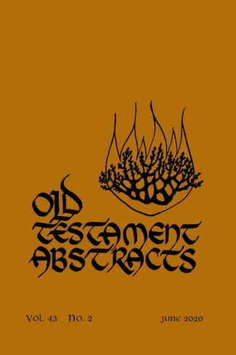
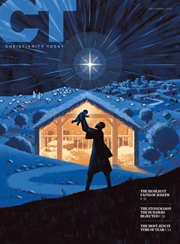
Academic vs Non-Academic Sources
Which journal would you cite in an assignment? Why?
What does it mean for a journal to be “peer reviewed”?
Notes:
These two covers on the screen are both journals held in the library. They are both good resources to use, but one is more suitable for academic research than the other. Which one would you use for an academic assessment? (OT Abstracts). What could you use Christianity Today for?
Another phrase that pops up a lot is “peer reviewed”. Who knows what that means?
Peer reviewed = experts in this field have read the articles and critiqued them before publication. That means the articles should be up to academic research standards, and the information should be correct and up to date.

Slide 15
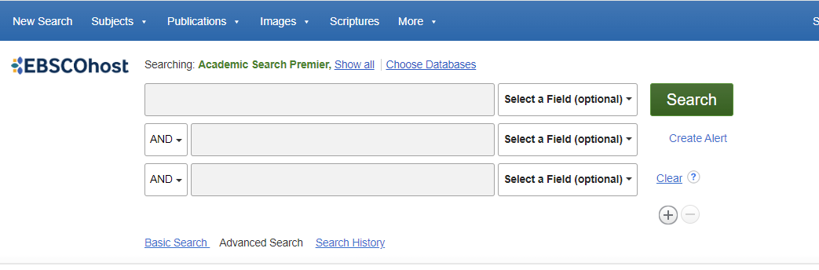
Online Resources – EBSCO 1

Slide 16
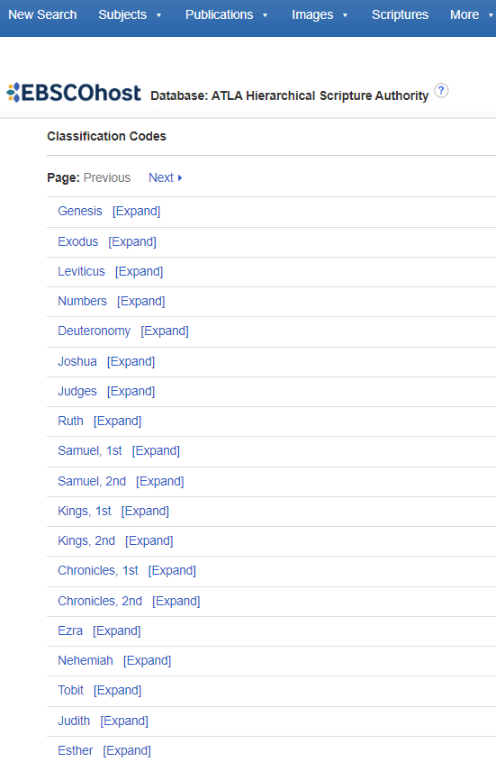
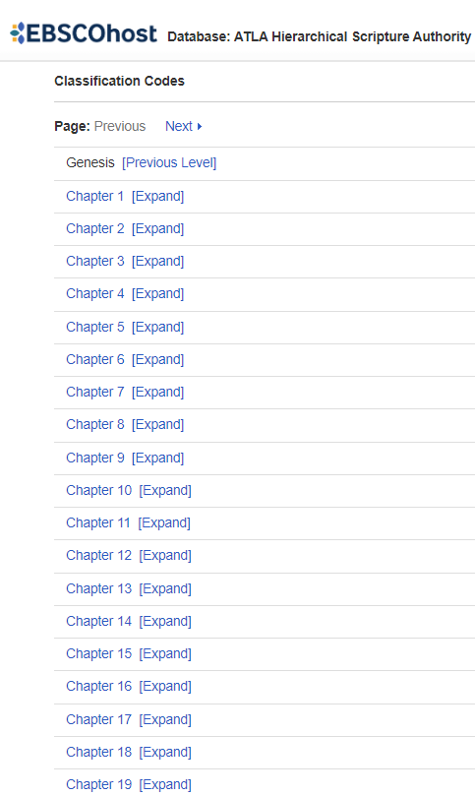
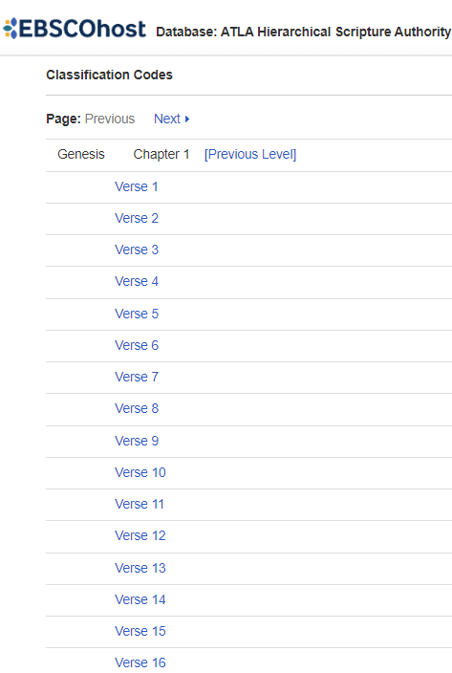
Online Resources – EBSCO 2

Slide 17
Online Resources – EBSCO (Keyword Search)

Slide 18
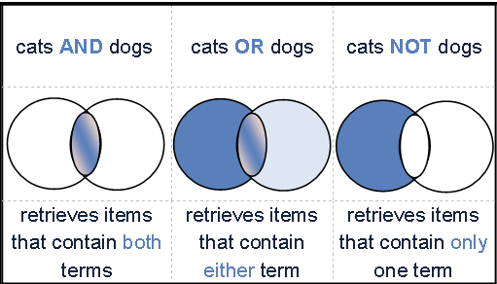
Boolean Operators
The Boolean operators AND, OR, and NOT -
- used to combine keywords when searching research databases.
- Makes your search more focused, thus yielding more precise search results.

Slide 19
Example Essay Question - 1
Why did the Crusades begin, how did they progress and what did they achieve? What has the long-term impact of the crusades been?
Let’s break down the question into four parts:
Why did the Crusades begin,
how did they progress and
what did they achieve?
What has the long-term impact of the crusades been?

Slide 20
Example Essay Question - 2
1) Why did the Crusades begin,
Keywords:
Crusades AND cause
“Crusades beginning” OR “crusades start” OR “first crusades”
Crusade* reason
“first crusade” NOT “second crusade”
2) how did they progress
Keywords:
“crusades development” OR “crusades progression”
“first crusade” AND “second crusade” AND “third crusade”

Slide 21
Example Essay Question - 3
3) what did they achieve?
Keywords:
“crusade* outcomes” OR “crusade* result” OR “crusade* achieve*”
“crusade* success” OR “crusade* fail*”
4) What has the long-term impact of the crusades been?
Keywords:
Crusade* AND “long term”
Crusade* AND effect
Crusade* AND change

Slide 22

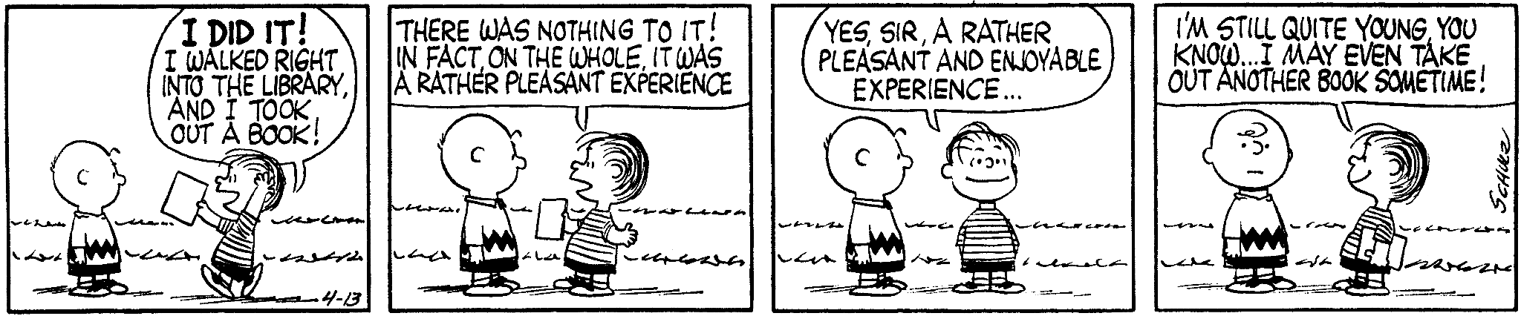
Questions?
1300 550 727
libraryhelpdesk@morling.edu.au
Schulz, C. (1960, April 13). Peanuts [daily strip].

