Slide 1
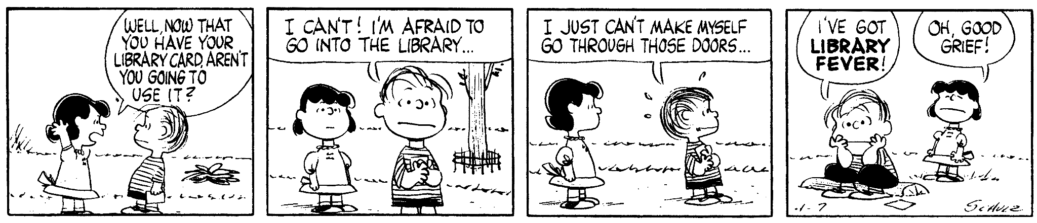
Library Orientation
Finding Your Way Around
Schulz, C. (1960, April 7). Peanuts [daily strip].
Notes:
Hi, I’m Michelle, and I work in the Library on level 2.

Slide 2
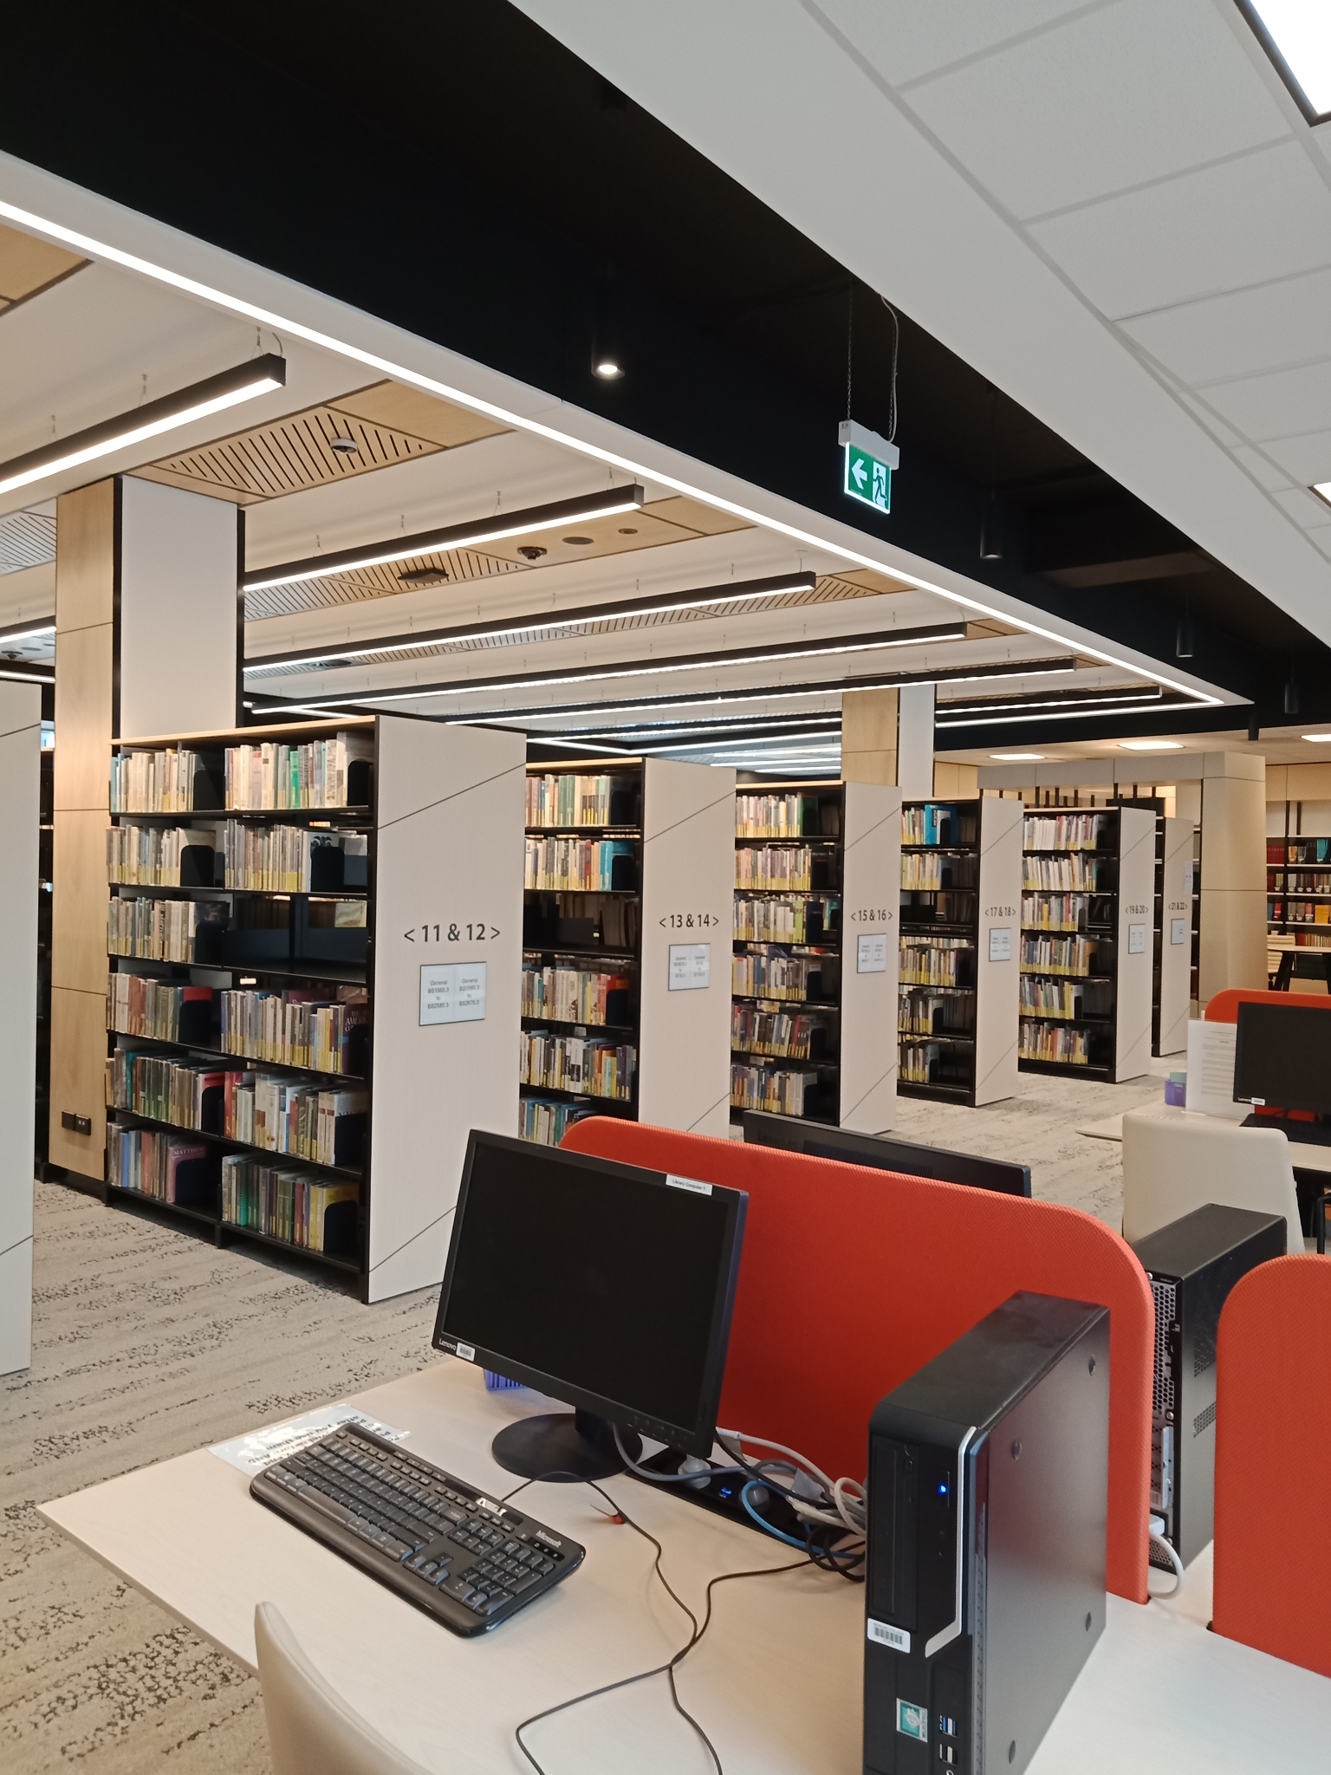
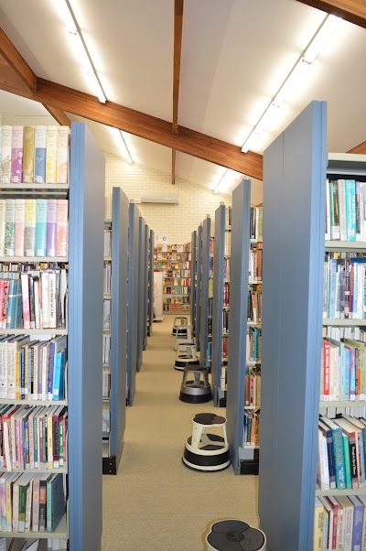

One Library, Three Branches
Gilbert Wright Library, Sydney
Heather and Noel Vose Library, Perth
TJ Malyon Library, Brisbane
219,000 resources
Over 75,000 eBooks
Journal databases

Slide 3
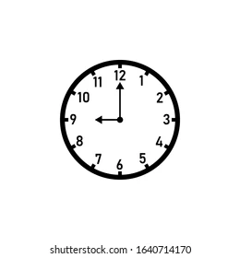
Opening hours during Semester
Level 1 - Study Hub
Monday- 8.30am to 4.30pm
Tuesday- 8:30am to 9:00pm
Wednesday & Thursday – 8.30am to 4.30pm
Friday, Saturday, Sunday and public holidays – Closed
https://www.morling.edu.au/library

Slide 4








What can the library help with?
libraryhelpdesk@morling.edu.au
Notes:
When did you last use an academic library? What did you use it for?
We can help in lots of ways - finding books (including posting them to distance students), keeping up to date with research, accessing paid resources, printing, search strategies, study spaces, and the whole research process.
The library also has reference and not for loan collections that are only available on campus. This is where we have your textbooks, encyclopedias, dictionaries and some commentaries - important books to use!

Slide 5



What CAN’T the library help with?
academictutor@morling.edu.au
Notes:
We can help with lots of things - but a few things we DON’T do include writing and editing essays, and knowing all your marking criteria and lecturers’ expectations.

Slide 6
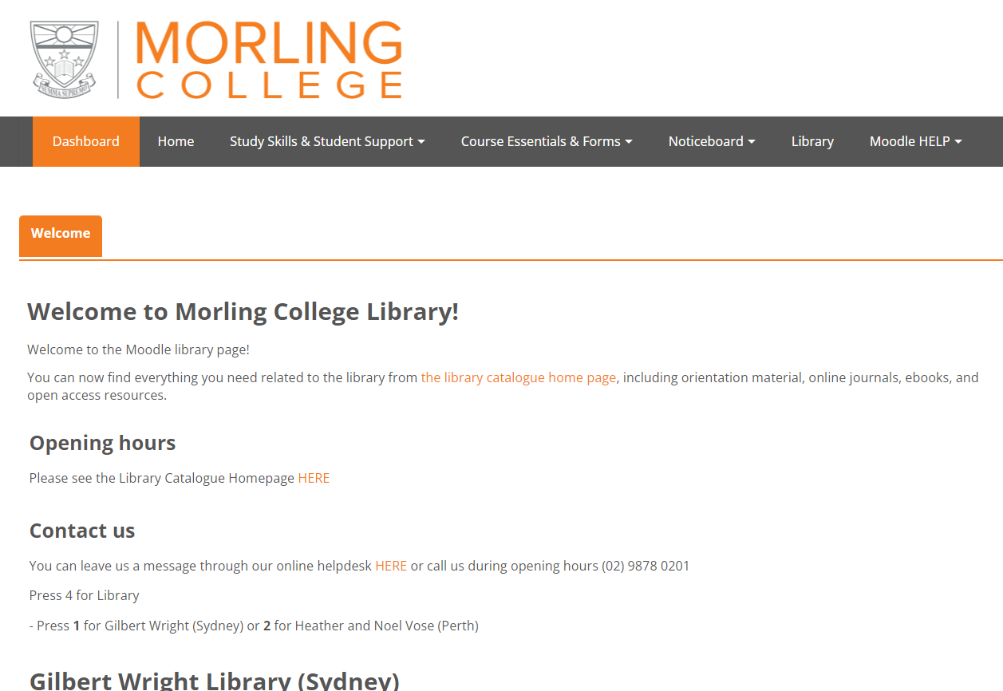
The Library on Moodle
https://www.morlingonline.edu.au/
Notes:
Should have received an email and one for OpenAthens activation
More details available on Moodle

Slide 7
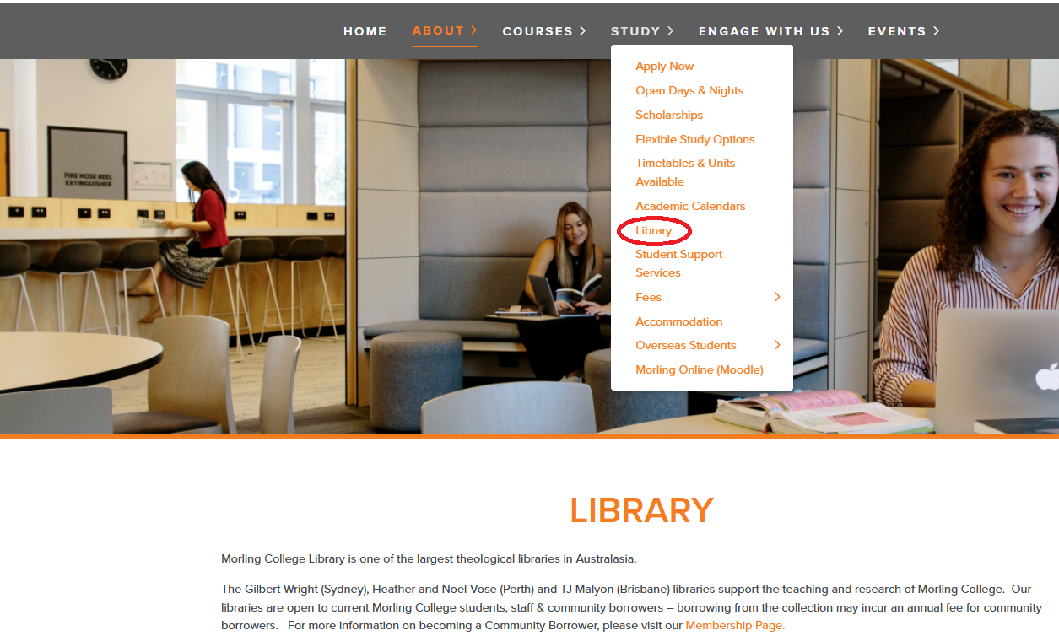
The Library Website
https://www.morling.edu.au/library

Slide 8
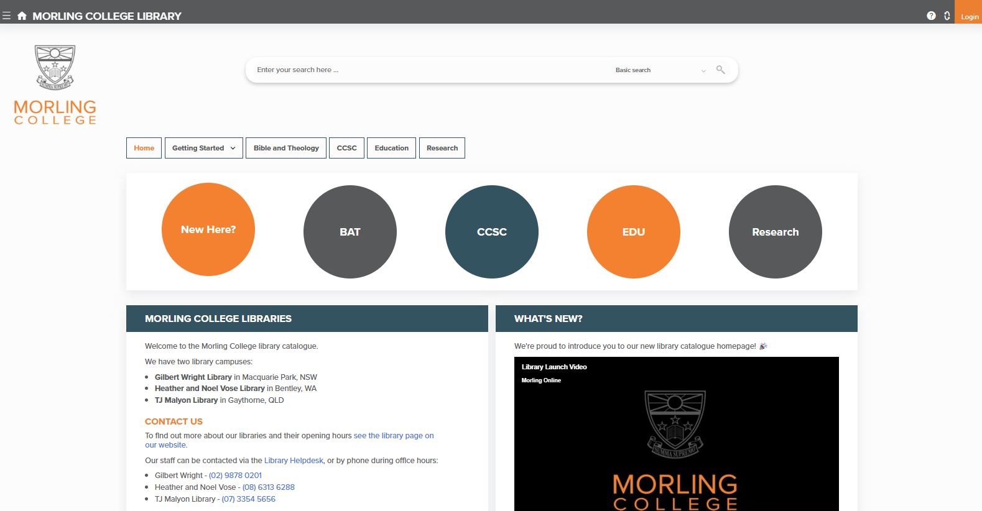
Library catalogue: Home
Basic and advanced search options
https://morling.softlinkhosting.com.au/liberty
Borrowing:
20 books
4 weeks
4 renewals
Notes:
This is the homepage of the library catalogue. On the Top middle is the search bar - and notice that there are options for both basic and advanced searching, to use some of the search techniques we’ll be learning. Top right is the login button. The circles in the middle is all about online resources for each of the departments at Morling. This is where the links to our journal databases and eBook collections are.

Slide 9
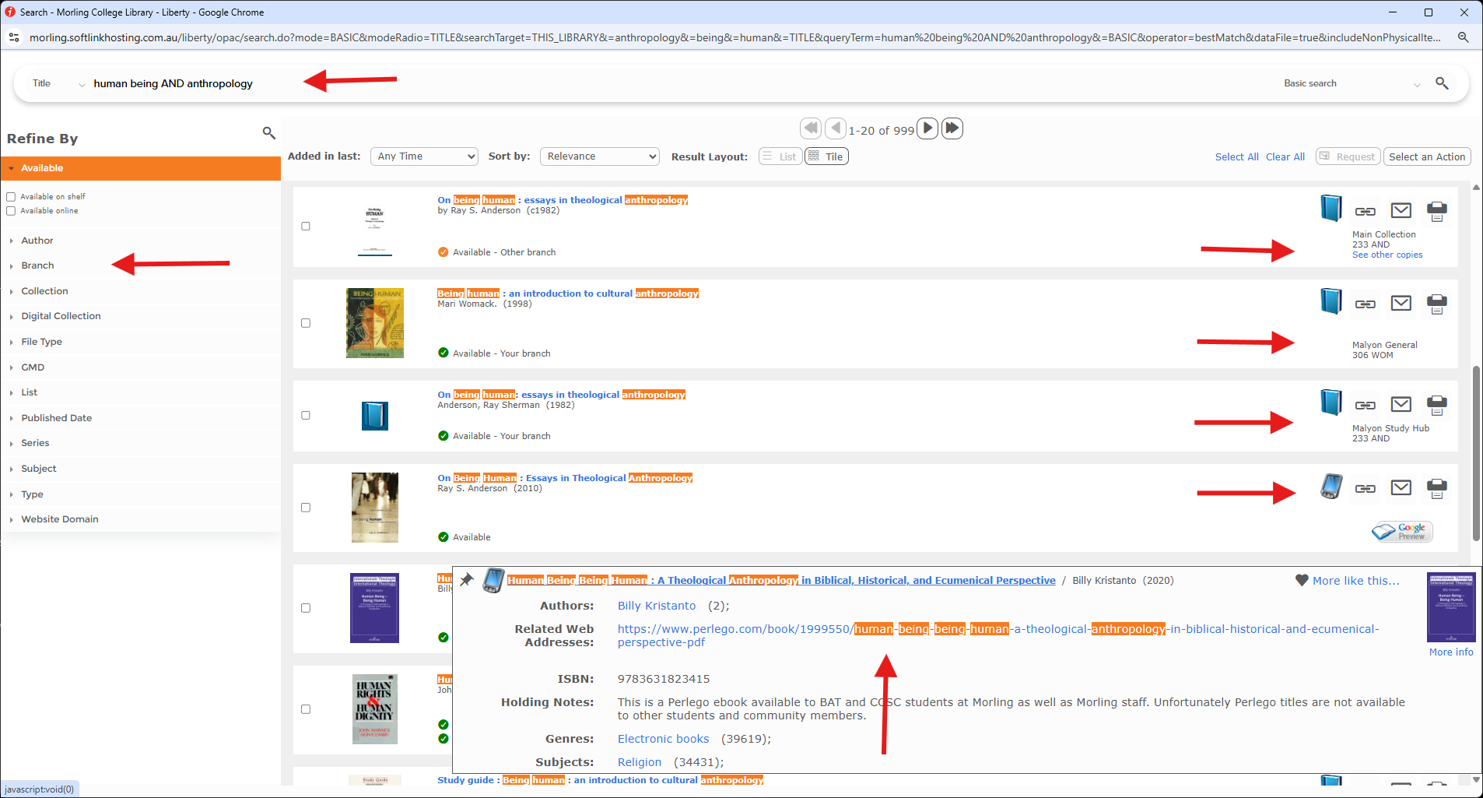
Library catalogue: Home
https://morling.softlinkhosting.com.au/liberty
Borrowing:
20 books
4 weeks
4 renewals
Notes:
This is the homepage of the library catalogue. On the Top middle is the search bar - and notice that there are options for both basic and advanced searching, to use some of the search techniques we’ll be learning. Top right is the login button. The circles in the middle is all about online resources for each of the departments at Morling. This is where the links to our journal databases and eBook collections are.
Once logged in you can Reserve books to collect from the library, Renew your loans (must be done before they become overdue - will not be able to borrow until they are returned)

Slide 10
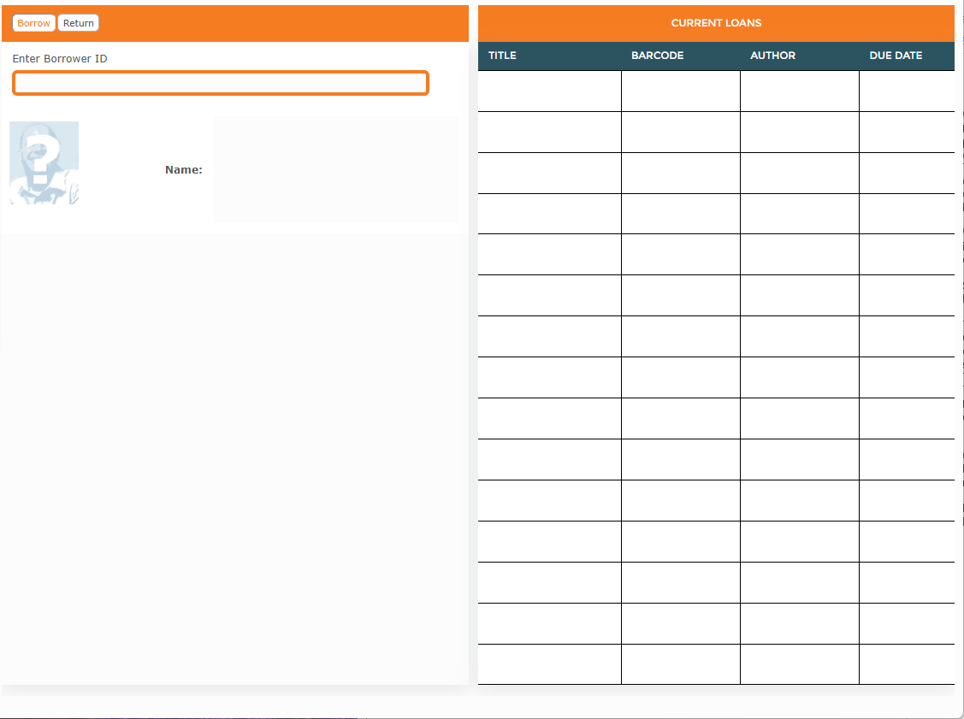
Borrowing and Returning
Self check-out and return system on both levels
Type your student number, then hit enter
Place returned books on the trolley beside the check-out terminal
After using resources in the library, please place them on the shelving trolleys provided
Ensure you check out books before leaving the college
No after hours returns chute currently

Slide 11
Finding print resources
Note the Classification number
225.61 POW - Dewey Decimal Classification system (DDC)
Followed by first letters of author’s surname:
230 ABU 230 DEV 1 230 DEV 2
On shelves in order of number, then alphabet
If preceded by:
‘R’, a Reference book (e.g. R 238 PEL Creeds and Confessions of Faith in the Christian Tradition / Pelikan & Hotchkiss.) Some are in the Study Hub
‘RA’, on the Atlas stand
‘Collection’ shows where it is located in the library
eg Malyon General is on the upper floor, Malyon Study Hub is on the lower level

Slide 12
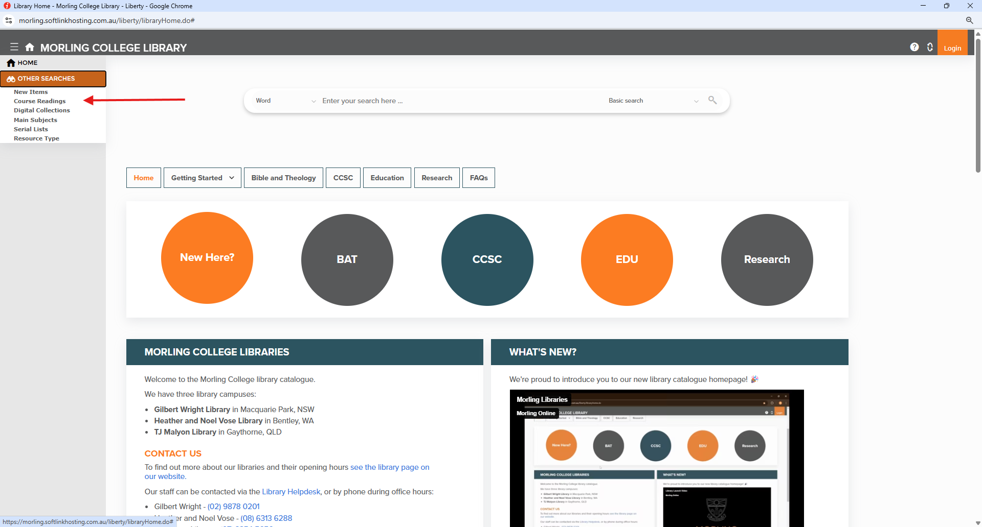
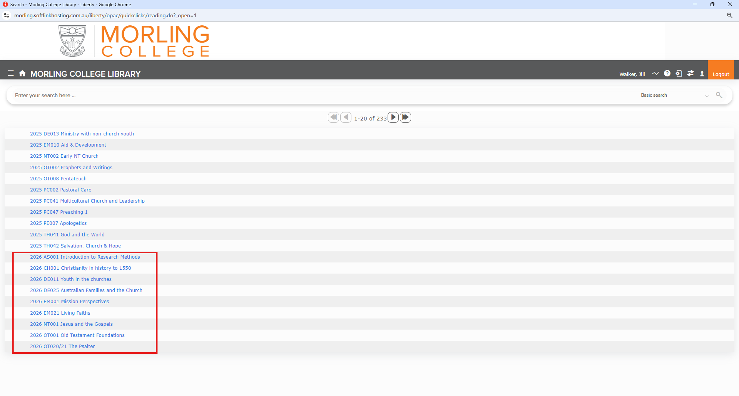
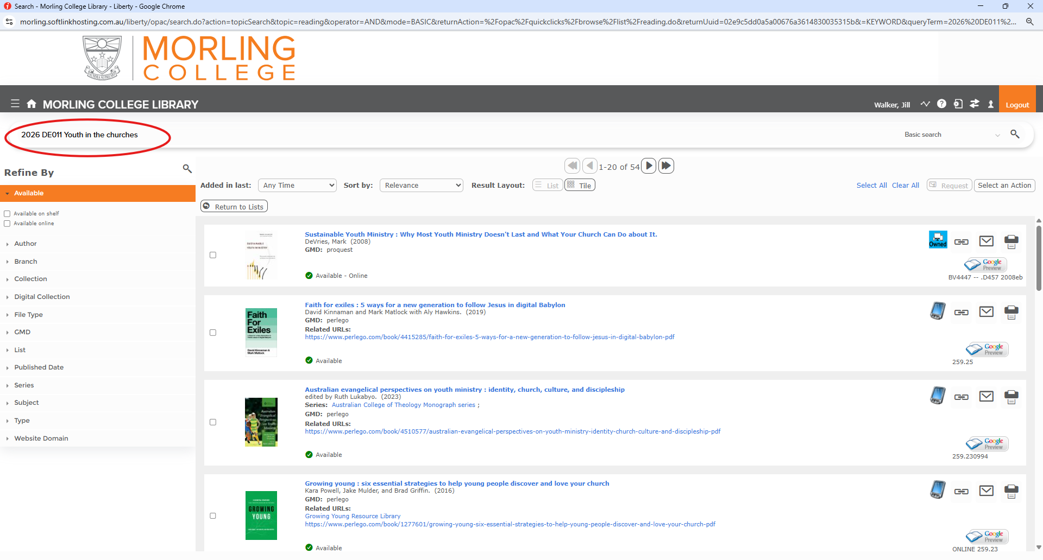
Course Reading Lists

Slide 13
Online Resources
eBooks |  |  |  |  | Journals
Perlego account | Wheelers account | OpenAthens account
Perlego Online Library | Wheelers Books | ProQuest Ebook Central | JSTOR | EBSCO (eBooks and journals) |  | ProQuest journals
Access
Platform
Notes:
Before we get to searching the databases, it’s helpful to know how to access the resources. These are our primary eResource platforms. There are quite a few of them, and they have different login systems. As you can see, OpenAthens is the main login system for our online resources, and the library creates an account for you. BUT, you will still need to use Perlego and Wheelers, so remember to register for them!
Each platform has its own quirks and features. For me, something that stands out between ProQuest and EBSCO is that when you search on EBSCO, you can search for eBooks and journal articles on the same platform. When you’re using ProQuest, you need to search for journals on one platform, and eBooks on another platform.

Slide 14
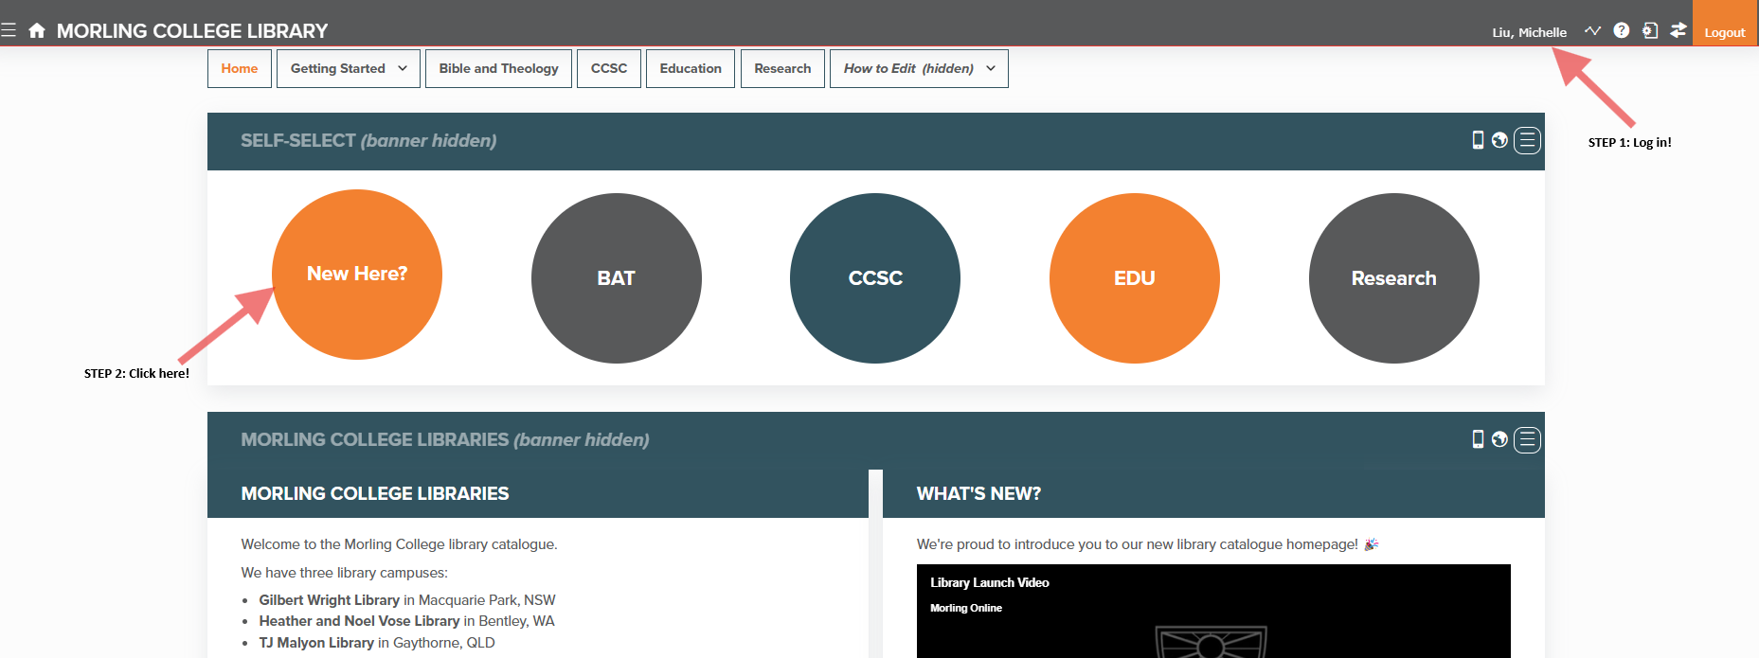
Online Resources – Perlego 1
Notes:
Before we get to searching the databases, it’s helpful to know how to access the resources. These are our primary eResource platforms. There are quite a few of them, and they have different login systems. As you can see, OpenAthens is the main login system for our online resources, and the library creates an account for you. BUT, you will still need to use Perlego and Wheelers, so remember to register for them!
Each platform has its own quirks and features. For me, something that stands out between ProQuest and EBSCO is that when you search on EBSCO, you can search for eBooks and journal articles on the same platform. When you’re using ProQuest, you need to search for journals on one platform, and eBooks on another platform.

Slide 15
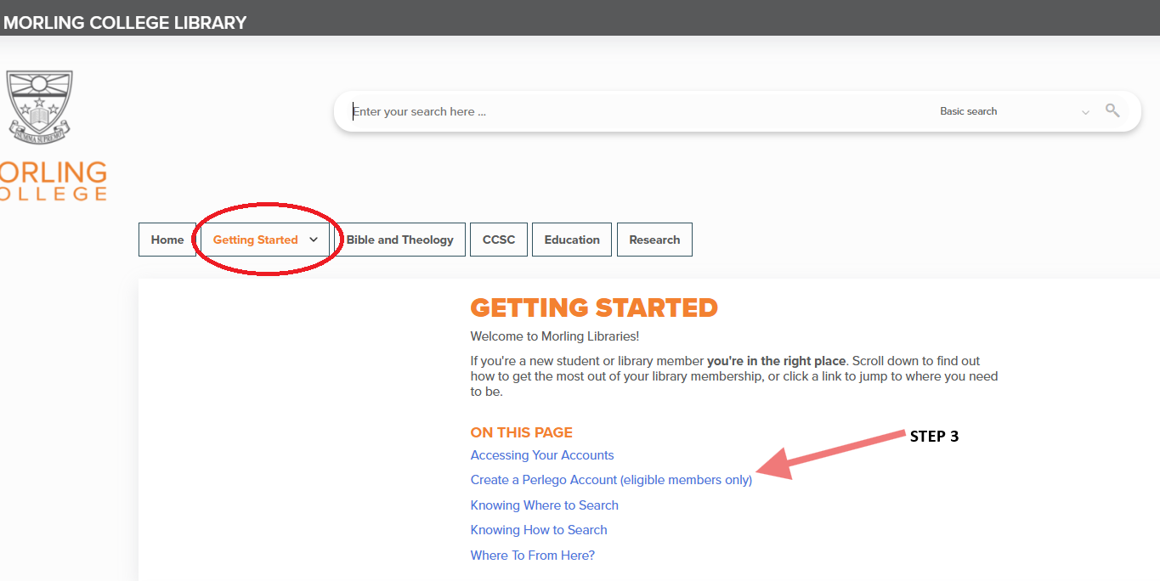
Online Resources – Perlego 2
Notes:
Before we get to searching the databases, it’s helpful to know how to access the resources. These are our primary eResource platforms. There are quite a few of them, and they have different login systems. As you can see, OpenAthens is the main login system for our online resources, and the library creates an account for you. BUT, you will still need to use Perlego and Wheelers, so remember to register for them!
Each platform has its own quirks and features. For me, something that stands out between ProQuest and EBSCO is that when you search on EBSCO, you can search for eBooks and journal articles on the same platform. When you’re using ProQuest, you need to search for journals on one platform, and eBooks on another platform.

Slide 16
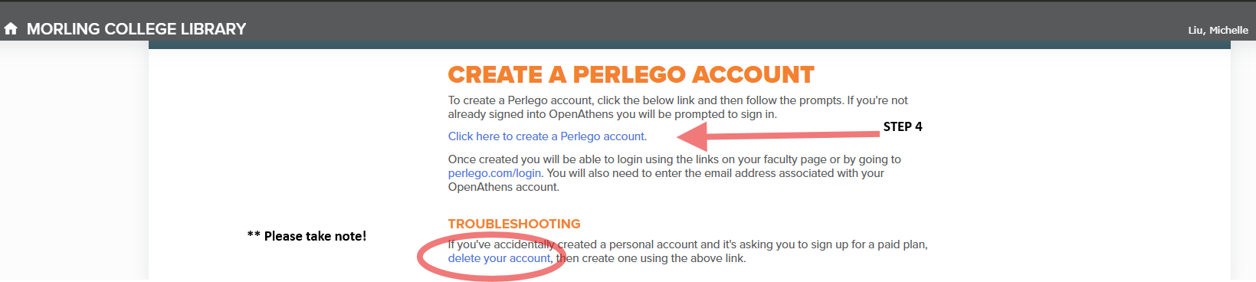
Online Resources – Perlego 3
Perlego Student Webinar - Tue 3 Mar 2026, 6pm Sydney time - Register here
Organise your reading and study more efficiently using notes, highlights & offline mode
If you can’t join, sign-up anyway so will receive the recording afterwards.
Notes:
Before we get to searching the databases, it’s helpful to know how to access the resources. These are our primary eResource platforms. There are quite a few of them, and they have different login systems. As you can see, OpenAthens is the main login system for our online resources, and the library creates an account for you. BUT, you will still need to use Perlego and Wheelers, so remember to register for them!
Each platform has its own quirks and features. For me, something that stands out between ProQuest and EBSCO is that when you search on EBSCO, you can search for eBooks and journal articles on the same platform. When you’re using ProQuest, you need to search for journals on one platform, and eBooks on another platform.

Slide 17
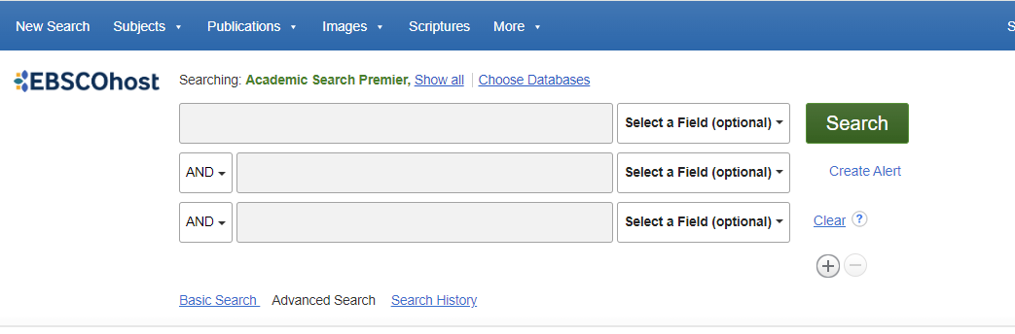
Online Resources – EBSCO (Keyword Search)

Slide 18
Online Resources – EBSCO 1

Slide 19
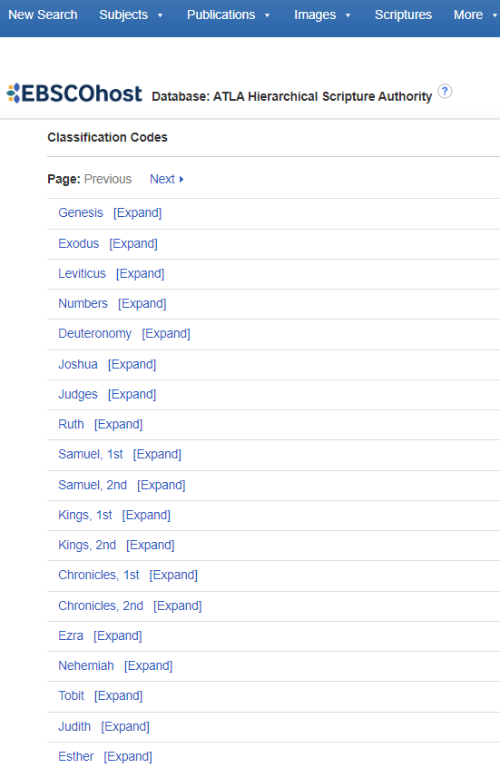
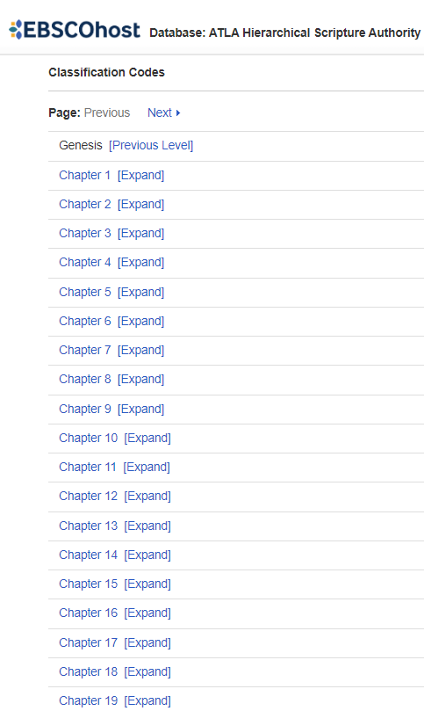
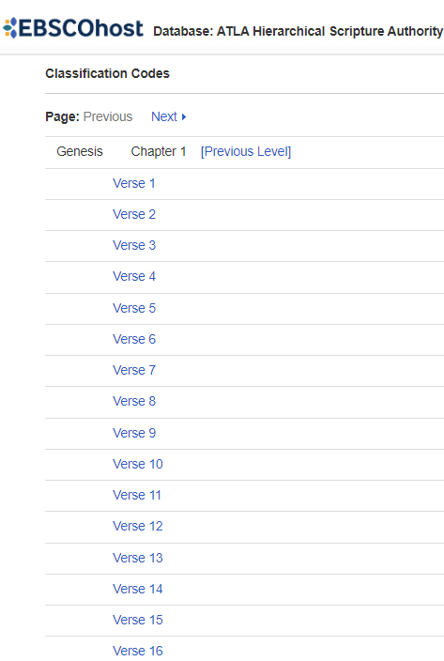
Online Resources – EBSCO 2

Slide 20
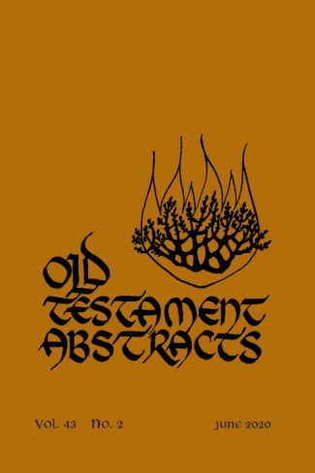
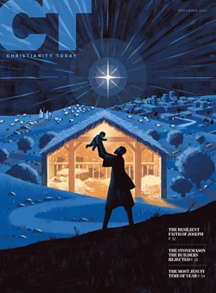
Academic vs Non-Academic Sources
Which journal would you cite in an assignment? Why?
What does it mean for a journal to be “peer reviewed”?
Notes:
These two covers on the screen are both journals held in the library. They are both good resources to use, but one is more suitable for academic research than the other. Which one would you use for an academic assessment? (OT Abstracts). What could you use Christianity Today for?
Another phrase that pops up a lot is “peer reviewed”. Who knows what that means?
Peer reviewed = experts in this field have read the articles and critiqued them before publication. That means the articles should be up to academic research standards, and the information should be correct and up to date.

Slide 21
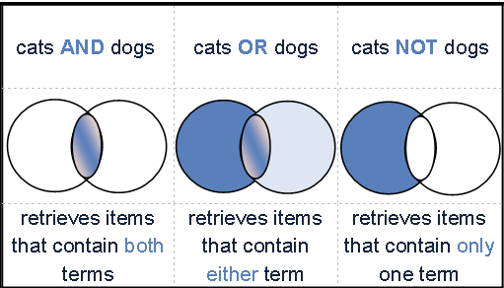
Boolean Operators
The Boolean operators AND, OR, and NOT -
- used to combine keywords when searching research databases.
- Makes your search more focused, thus yielding more precise search results.

Slide 22
Example Essay Question - 1
Why did the Crusades begin, how did they progress and what did they achieve? What has the long-term impact of the crusades been?
First break down the question into four parts:
Why did the Crusades begin,
how did they progress and
what did they achieve?
What has the long-term impact of the crusades been?

Slide 23
Example Essay Question - 2
1) Why did the Crusades begin,
Keywords:
Crusades AND cause
“Crusades beginning” OR “crusades start” OR “first crusades”
Crusade* reason
“first crusade” NOT “second crusade”
2) how did they progress
Keywords:
“crusades development” OR “crusades progression”
“first crusade” AND “second crusade” AND “third crusade”

Slide 24
Example Essay Question - 3
3) what did they achieve?
Keywords:
“crusade* outcomes” OR “crusade* result” OR “crusade* achieve*”
“crusade* success” OR “crusade* fail*”
4) What has the long-term impact of the crusades been?
Keywords:
Crusade* AND “long term”
Crusade* AND effect
Crusade* AND change

Slide 25

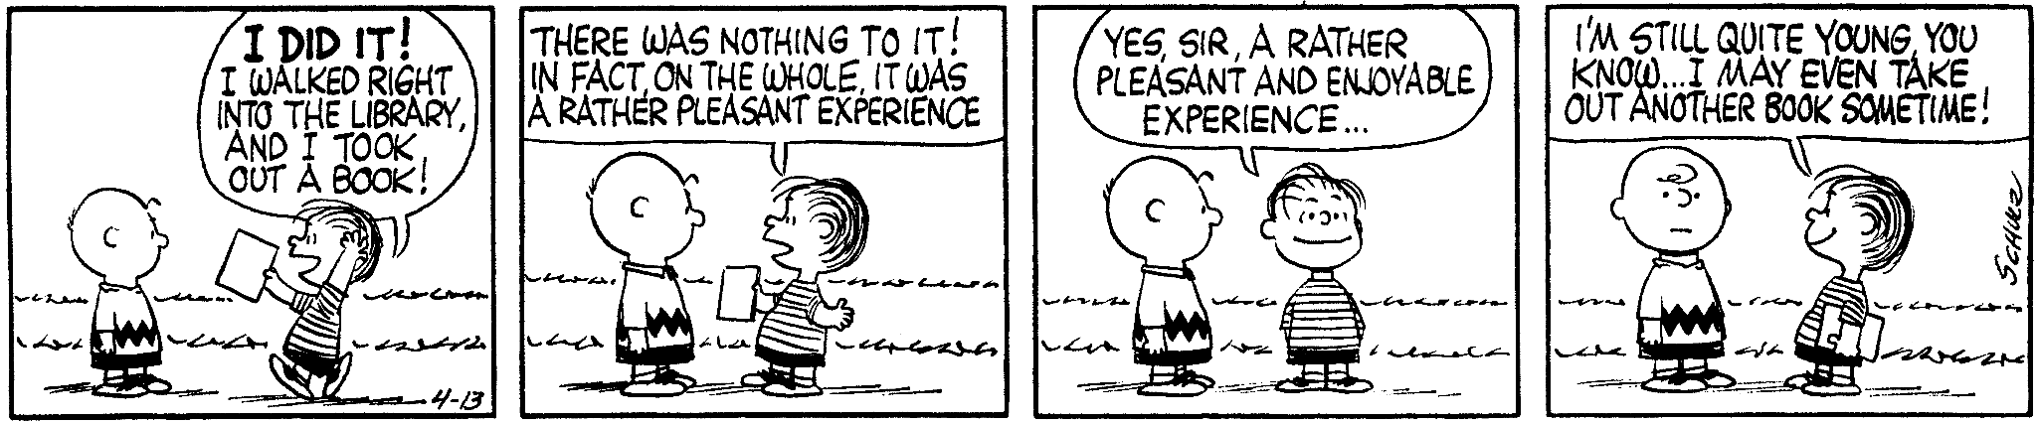
Questions?
1300 550 727 ext 325 Jill
libraryhelpdesk@morling.edu.au
Schulz, C. (1960, April 13). Peanuts [daily strip].

